Slide 1
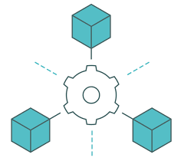

Choreography-based saga using spring boot
SAGA pattern Choreography
By
Hassan FARSI & Driss ALLAKI

Slide 2

Objectives
The objective of this demo is to :
Be able to implement transactions that span multiple services.
Understand the great benefits of this pattern by implementing spring boot.
Get familiar with Apache Kafka and the Event-Driven architecture.

Slide 3
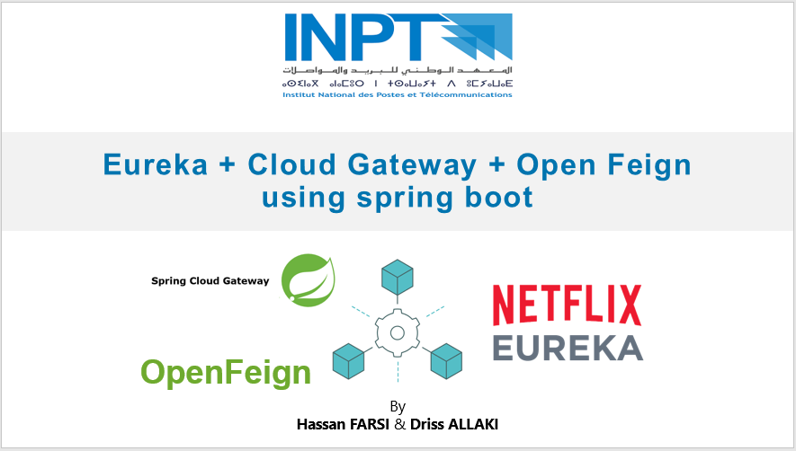

Prerequisites 1
This demo is based on the last project (Eureka / API Gateway / OpenFeign project)

Slide 4
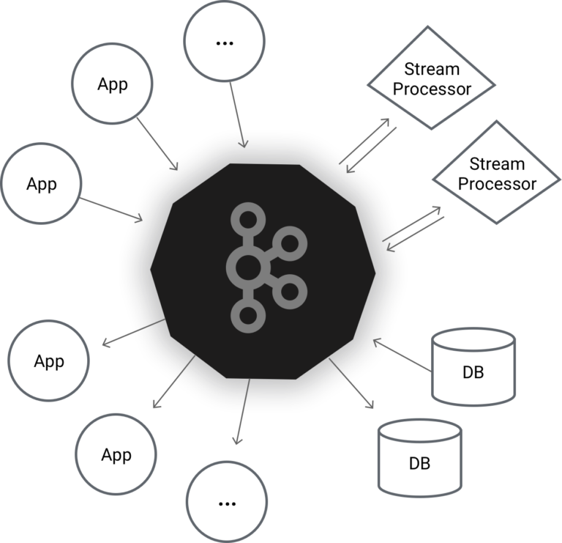

Prerequisites 2
Service A
Events channel
Service B
Install this
https://www.youtube.com/watch?v=P_tmrpNh12o&ab_channel=JavaShastra

Slide 5



Create new order
Client (Browser or Postman)
(13) Client
Response
(1) New order request
(12) New order Response
<API Gateway>
Spring Cloud Gateway
(2) Get registry
<Service registry>
Eureka Netflix
(3) Create new order
OpenFeign
(4) getProductByid ()
(11) Update
[PROCESSING/
FAILED]
Order Service
(6)
(7)
Product
Service
Produce
order-event
Consume
Order event producer
(5) Save [CREATED]
Order event responder
Product event consumer
(10)
(8) Update (extend)
(9)
H2 DB
product-event
Produce
H2 DB
Consume

Slide 6
Nominal scenario
The SAGA Choreography pattern will concern the createOrder() method.
We assume that an order is made for one product by a product_id along with the quantity.
The OpenFeign client is used to get the product data from the product_service in order to calculate the order’ price.
In order to create a new order we need to check the product availability.
The order_service will receive the new order information, then it will create and save it in the DB with a CREATED order state.
The order_service send an order event to the product_service in order to check if the product is available or not, and update the product DB.
If the product is available, the product service will update the items number in the product DB and then send a product event with the AVAILABALE state to the order_service. If the product is out of stock the product event will gather an OUT_OF_STOCK state.
If the product state is AVAILABALE, the order_service will update the state of the order to PROCESSING, if not it will be changed to FAILED.

Slide 7
The process
Step 1 : Update the services from the last demo to use h2 database, and save some initial data to work with.
Step 2 : Define in a new separated project the Data Transfer Objects (DTOs) to share classes between projects. The shared set of classes between the two services will be used to handle the events. (The DTOs (Clsses to share) are : OrderEvent, ProductEvent, OrderState (enum), ProductState (enum)).
Step 3 : Add the necessary maven dependencies to the order_service and the product_service, including the DTO’s project dependency.
Step 4 : Implement the new createOrder() method. Save the new order and publish the order event.
Step 5 : Implement the product_service replier that consume an order event and return a product event.
Step 6 : From the order_service, consume the product event and take the appropriate actions.
Step 7 : Run the kafka server and test the app.

Slide 8

STEP 1

Slide 9
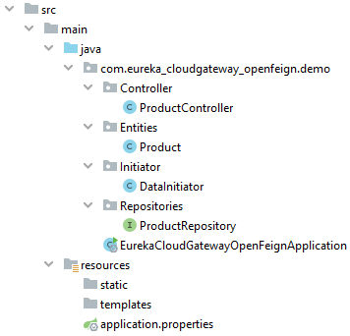
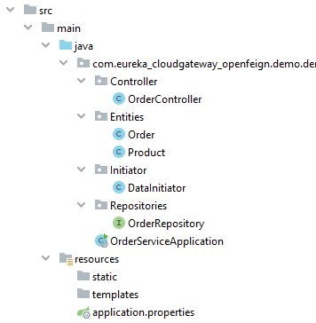
Step 1 : Update the services
product_service
order_service
Initiate the database with some values
<dependency> <groupId>com.h2database</groupId> <artifactId>h2</artifactId> <scope>runtime</scope> </dependency>
<dependency> <groupId>org.springframework.boot</groupId> <artifactId>spring-boot-starter-data-jpa</artifactId> </dependency>

Slide 10
Step 1 : Update the services
@Component public class DataInitiator implements ApplicationListener<ContextRefreshedEvent> { @Autowired private ProductRepository productRepository; @Override public void onApplicationEvent(ContextRefreshedEvent event) { if(event.getApplicationContext().getParent() == null) { productRepository.save(new Product("HTC Electric Shaver", 80, 10, "An electric shaver")); productRepository.save(new Product("Arduino Uno", 150, 20,"A microcontroller board")); productRepository.save(new Product("Canon EOS M100", 5500, 3,"Canon camera")); } } }
product_service
(DataInitiator)
Don’t forget to create the ProductRepository and add the necessary JPA annotations to the Product class

Slide 11
Step 1 : Update the services
@Component public class DataInitiator implements ApplicationListener<ContextRefreshedEvent> { @Autowired private OrderRepository orderRepository; @Override public void onApplicationEvent(ContextRefreshedEvent event) { if(event.getApplicationContext().getParent() == null) { orderRepository.save(new Order(160, new Date(), OrderState.CREATED)); orderRepository.save(new Order(360, new Date(), OrderState.CREATED)); orderRepository.save(new Order(5500, new Date(), OrderState.CREATED)); } } }
order_service
(DataInitiator)
Don’t forget to create the OrderRepository and add the necessary jpa annotations to the Order class

Slide 12
STEP 2

Slide 13
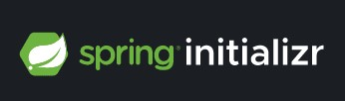
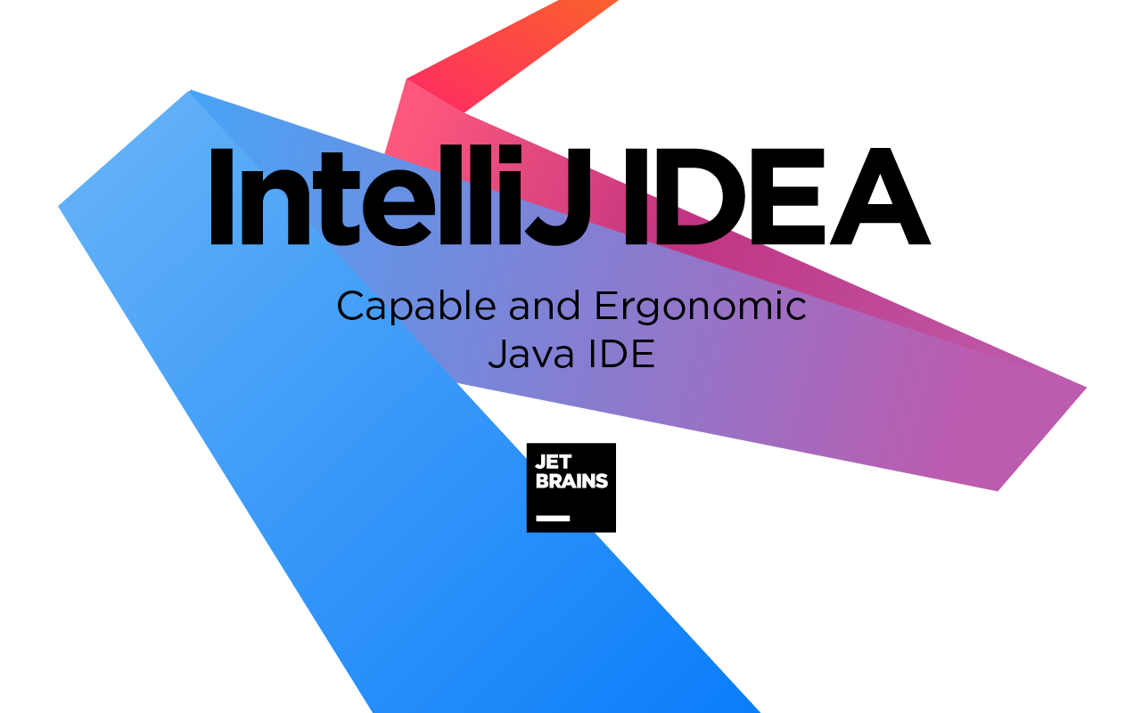

Step 2: Data Transfer Objects (DTOs)
Intellij
Eclipse
Create a new project “DataTransferObject”

Slide 14
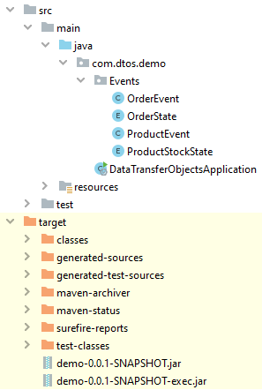

Step 2: Data Transfer Objects (DTOs)
public class OrderEvent { private Long orderId; private Long prodId; private int prodqnt;
}
public enum OrderState { CREATED, PROCESSING, PICKEDUP, DELIVERED,
FAILED }
(1)
(2)
// An OrderState optional
field could be added here
public enum ProductStockState { AVAILABLE, OUT_OF_STOCK }
(3)
public class ProductEvent { private Long orderId; private Long prodId; private int prodqnt; private ProductStockState stockAvailability; }
(4)
DTOs Project

Slide 15
Step 2: Data Transfer Objects (DTOs)
<plugin> <groupId>org.springframework.boot</groupId> <artifactId>spring-boot-maven-plugin</artifactId> <configuration> <classifier>exec</classifier> </configuration> </plugin>
In pom.xml add the above plugin. Then execute the “mvn clean install” command to create the jar files
To inject the classes of the DTO project in other projects use the following dependency syntax with the appropriate data, from the pom.xml file. (All the other projects must have this dependency)
<dependency> <groupId> .. </groupId> <artifactId> .. </artifactId> <version> .. </version> <scope>system</scope> <systemPath> .. The generated jar file path .. </systemPath> </dependency>
Typical import Jar
DTOs Project
Execution Jar

Slide 16
STEP 3

Slide 17
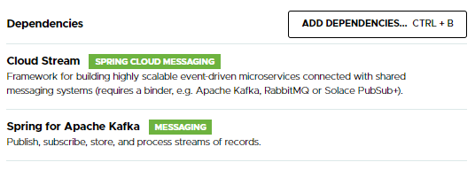

Step 3: Maven dependency
Add to the Order and the product services the Cloud Stream and Apache Kafka dependencies. Do not forget the DTO project dependency.
<dependency> <groupId> .. </groupId> <artifactId> .. </artifactId> <version> .. </version> <scope>system</scope> <systemPath> .. The generated jar file path .. </systemPath> </dependency>
DTOs Project dependency

Slide 18
STEP 4

Slide 19
Step 4: New order_service
(1) /prodId/qnt
OpenFeign
(2) getProductByid ()
Product
Service
H2 DB
Order Service
(5)
Produce
order-event
Order event producer
(3) Save [CREATED]
(4)
H2 DB
Controller endpoint
Get product data
Save the order
Configure the kafka topic
Create and send an order event
order_service

Slide 20
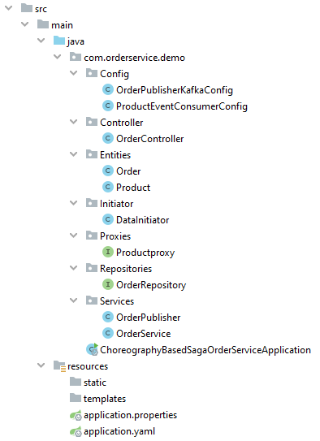
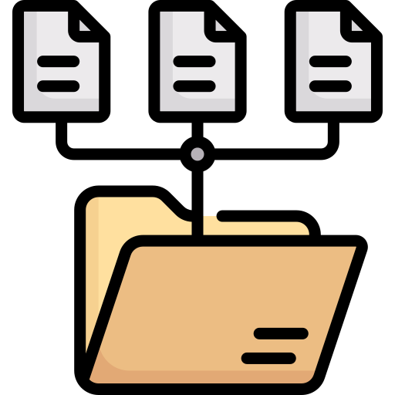
Step 4: New order_service
Kafka order-event configuration
Product event consumer
(To handle after the product producer is ready)
Order event producer
OrderService class
Kafka properties
order_service

Slide 21
Step 4: New order_servie
@GetMapping("/new/{prodId}/{qnt}") public Order createOrder(@PathVariable long prodId, @PathVariable int qnt){ // saveOrder of the order service return orderService.saveOrderInDB(prodId, qnt); }
Controller package : OrderController
class
public Order saveOrderInDB(long prodId, int qnt){
// (To do) Get the concerned product from the product_service using OpenFeign (In order to get the product price) // (To do) Create and save the new order in the database.
// Publish the orderEvent to the product service orderPublisher.publishOrderEvent(newOrder, prodId, qnt);
return newOrder; }
Services package : OrderService
class
@Autowired private Sinks.Many<OrderEvent> orderSinks;
public void publishOrderEvent(Order newOrder, long prodId, int qnt){ // Create an order event with the necessary data and send it. OrderEvent orderEvent = new OrderEvent(newOrder.getId(), prodId, qnt); orderSinks.tryEmitNext(orderEvent); }
Services package : OrderPublisher class

Slide 22
Step 4: New order_servie
@Configuration public class OrderPublisherKafkaConfig {
// Order events will be sent to all the subscribers @Bean public Sinks.Many<OrderEvent> orderSinks(){ return Sinks.many().multicast().onBackpressureBuffer(); }
// Order event supplier (We will supply multiple order events) @Bean public Supplier<Flux<OrderEvent>> orderSupplier(Sinks.Many<OrderEvent> sinks){ return sinks::asFlux; } }
Config package : OrderPublisherKafkaConfig
class

Slide 23
Step 4: order_service .yaml
spring: cloud: stream: function: # Define the supplier and the consumer to
use by the order service definition: orderSupplier;productEventConsumer bindings: # Define the supplier as an output of
the event orderSupplier-out-0: # Kafka topic or the channel destination
name (Any name you want, needs to be meaningful) destination: order-event # Define the consumer as an input for
the event productEventConsumer-in-0: # Kafka topic or the channel name to
receive the event from
(Any name you want, needs to be meaningful) destination: product-event
application.properties contains the application general properties (name, database, eureka location, etc.)
application.yaml will contain the kafka properties.
The figure beside shows the final version of the order_service application.yaml file
order_service : application.yaml

Slide 24
STEP 5

Slide 25
Step 5: product_service consumer
(1)
Product
Service
Produce
order-event
Consume
Order
Service
H2 DB
Order event responder
(4)
(3) Update (extend)
product-event
Produce
H2 DB
Create the order event responder
DB update if needed
Configure the kafka topic
Produce and send a product event
product_service

Slide 26
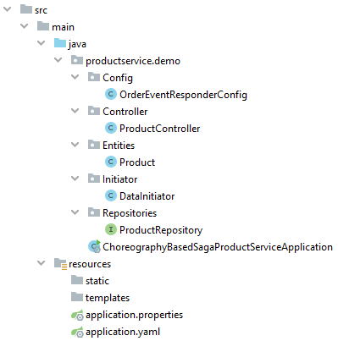
Step 5: product_service consumer
Order event responder (Input : OrderEvent, Output : ProductEvent)
Kafka properties
product_service

Slide 27
Step 5: product_service consumer
Config package : OrderEventResponderConfig
Class/
orderEventProcessor()
@Configuration public class OrderEventResponderConfig { @Autowired private ProductRepository productRepository; @Bean public Function<Flux<OrderEvent>, Flux<ProductEvent>> orderEventProcessor(){ return orderEventFlux -> orderEventFlux.flatMap(this::productStockCheck); }
. . . . . . . . . . . . . .
. . . (Code in the next slide) . . .
. . . . . . . . . . . . . .
}

Slide 28
Step 5: product_service consumer
private Mono<ProductEvent> productStockCheck(OrderEvent orderEvent){
// (To do) Get the product from the DB using the orderEvent prodId.
// (To do) Create a ProductStockState variable with an AVAILABLEvalue if the product item number
is higher than the orderEvent qnt, else an OUT_OF_STOCK should be assigned.
// (To do) Subtract the number of items requested from the product available item number.
Then update the product values in the database
// Initiate a productEvent ProductEvent productEvent = new ProductEvent( orderEvent.getOrderId(), orderEvent.getProdId(), orderEvent.getProdqnt(), stockAvailability);
// Return the productEvent to the order service. return Mono.fromSupplier(() -> productEvent); }
Config package : OrderderConfig
Class
Config package : OrderEventResponderConfig
Class/
productStockCheck()

Slide 29
Step 5: product_service .yaml
spring: cloud: stream: function: definition: orderEventProcessor bindings: orderEventProcessor-in-0: destination: order-event orderEventProcessor-out-0: destination: product-event
orderEventProcessor handle the input of the order-event topic
orderEventProcessor produce an output and send it via the product-event topic
product_service : application.yaml

Slide 30
STEP 6

Slide 31
Step 6: order_service consumer
@Configuration public class ProductEventConsumerConfig { @Autowired private OrderService orderService; @Bean public Consumer<ProductEvent> productEventConsumer(){ return (productEvn) -> orderService.updateOrde(productEvn); } }
Config package :
ProductEventConsumerConfig
Class
Services package :
OrderService
Class
public void updateOrde(ProductEvent prdct){
// (To do) Get the concerned order from the database using the ProductEvent’s orderId
// (To do) Depending on the received product event, change the order state to PROCESSING or FAILED
// (To do) Update the DB order data. } }

Slide 32
STEP 7

Slide 33
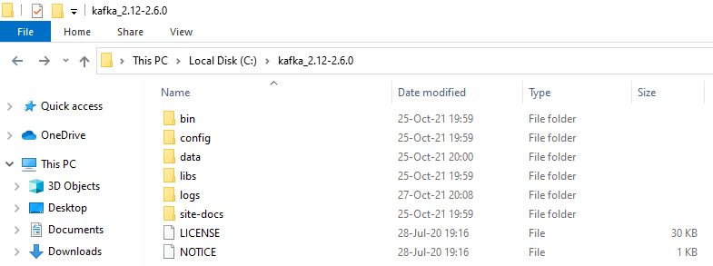
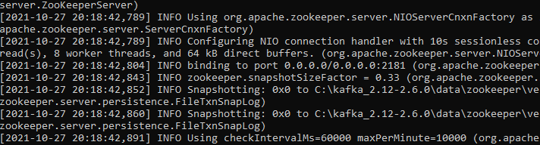
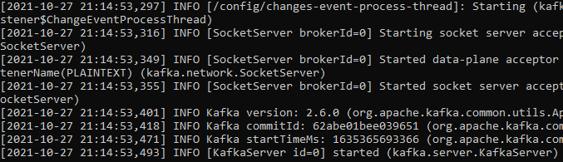
Step 7: Run and test
(2)
(1)
(3)
Before starting the server make sure that the folders data/kafka and data/zookeeper are empty.
Run the Kafka server

Slide 34
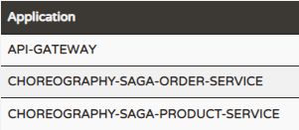
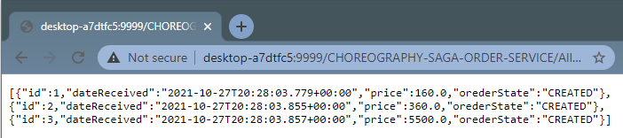
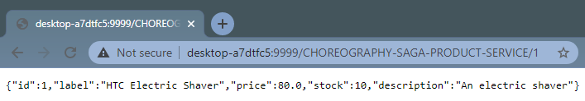

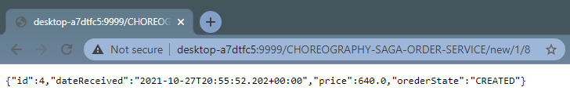
Step 7: Run and test
All Orders
Product : 1
In case of any problem With Eureka DNS system, try adding the following line to all the projects : eureka.instance.hostname=localhost
Create new Order
{prodId : 1, qnt : 8}

Slide 35
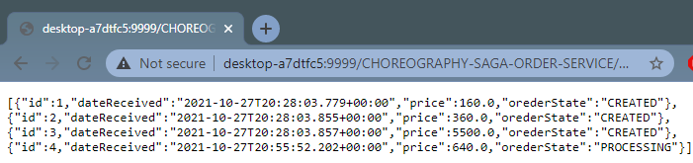
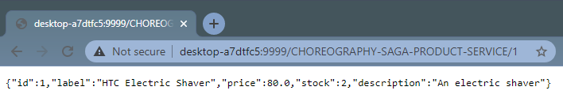
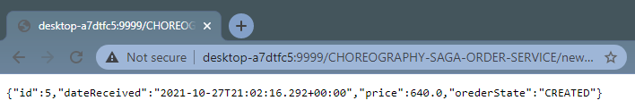
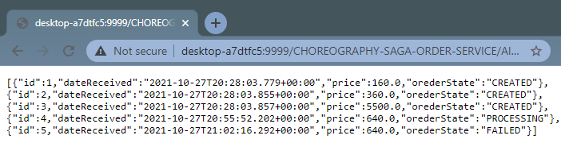
Step 7: Run and test
Product is available:
OrderState : Processing
Product number of items has been changed
Create new order with product out of stock
Order failed

Slide 36
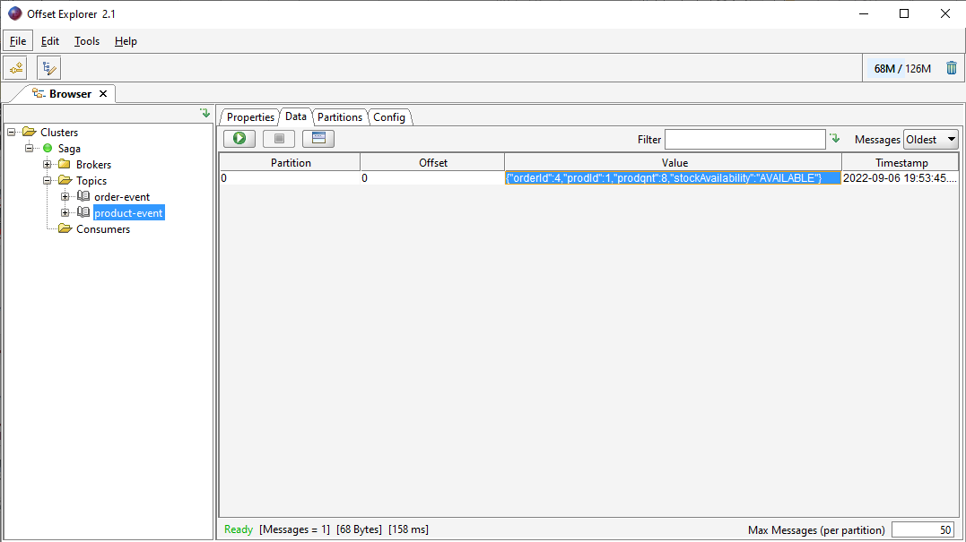
Step 7: Run and test
Offset Explorer

Slide 37
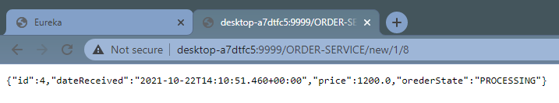


Step 7 : Run and test

Slide 38

SAGA pattern Choreography

